Slide 1
Complications of CPAP
Notes:
In this webinar we would learn the complications and necessary interventions to avoid them ..

Slide 2
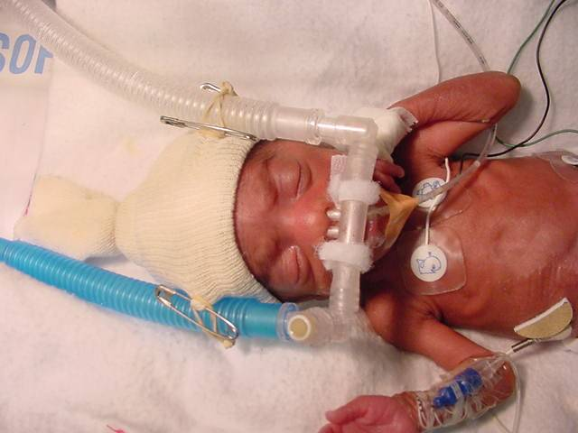
CPAP Complications
Respiratory
NASAL
Cardiac
GI tract
Do not take CPAP lightly!
Notes:
Any newborn on CPAP requires extensive monitoring for complications. The complications are related to nasal injury, air-leaks, CPAP Belly and hemodynamic instability.

Slide 3
Columellar Notch
Columellar transection
Distance between Prong and the Columella
Notes:
Injuries such as columellar notch and columellar transaction are prevented by maintainig the distance between the nasal prongs and the columella and preventing the weight of CPAP circuit to fall on the nose…

Slide 4
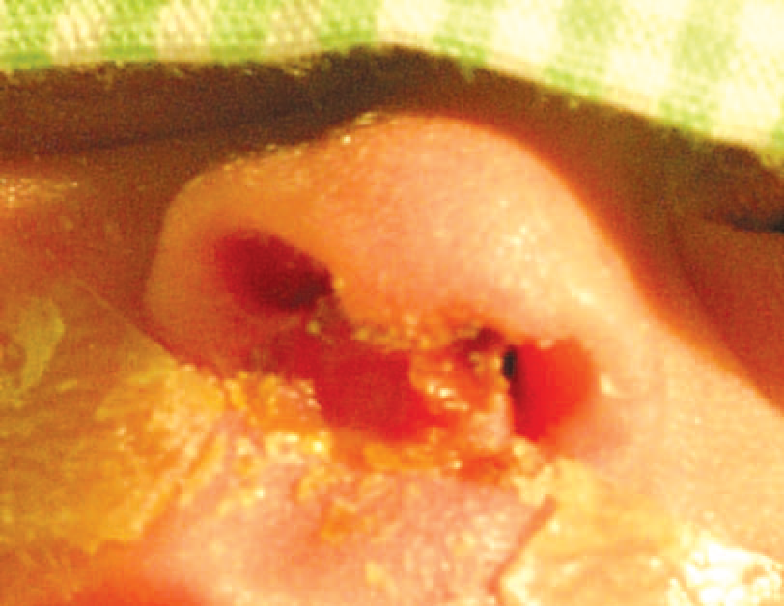
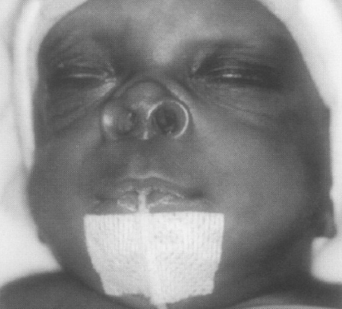
Nasal septum damage
Size and softness of the Nasal Prongs
Notes:
Injuries such as septal damage and flaring of nostrils are preventing by using appropriate size of the prongs and also by ensuring the correct softness of the prongs

Slide 5
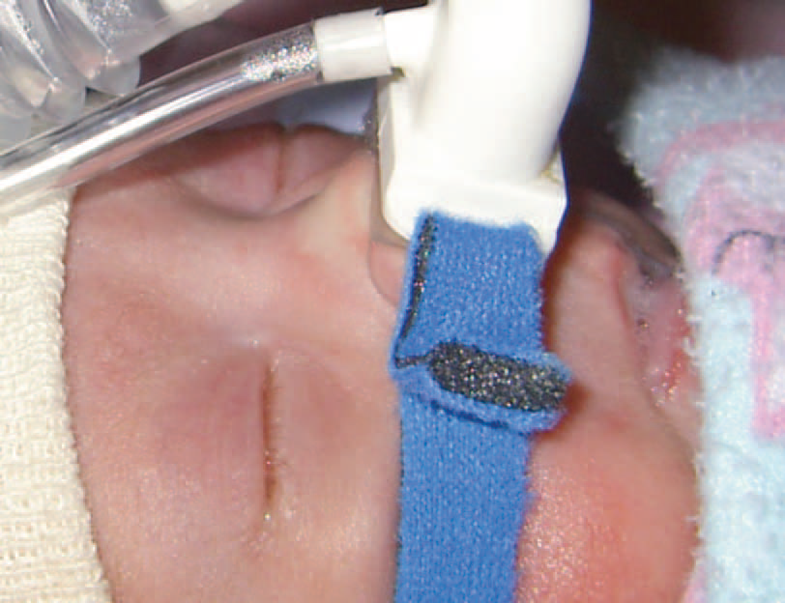
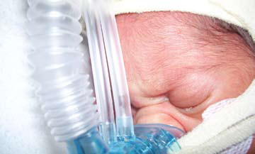
Snubbing while on NCPAP
Notes:
Prevention of Snubbing is needed to prevent pressure sores and skin injury.

Slide 6
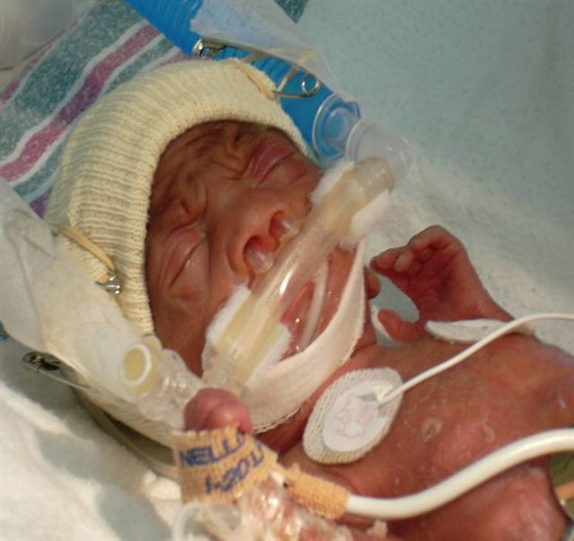
Nasal septal injury is Preventable
Careful observation
Correct prong size
Correct prong position
Gap between prongs and columella
Effective attachment
Monitor/view the infant and the device every hour
Notes:
Overall Nasal and Nasal Septal injury is preventable by careful observation, using correct prong size, appropriate prong fixation and and attachment of prongs to cap and CPAP tubings

Slide 7
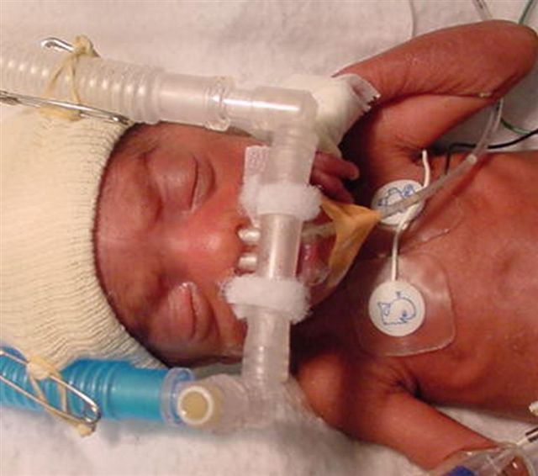
Maintain skin integrity
Frequent observation
Minimize points of contact
Keep dry and clean
Avoid topical applications
Notes:
Injury to the skin over the upper limb, chin and nose is prevented by frequent observation, minimizing the points of contact, keeping the area clean and dry and by avoiding topical paints or ointments..

Slide 8
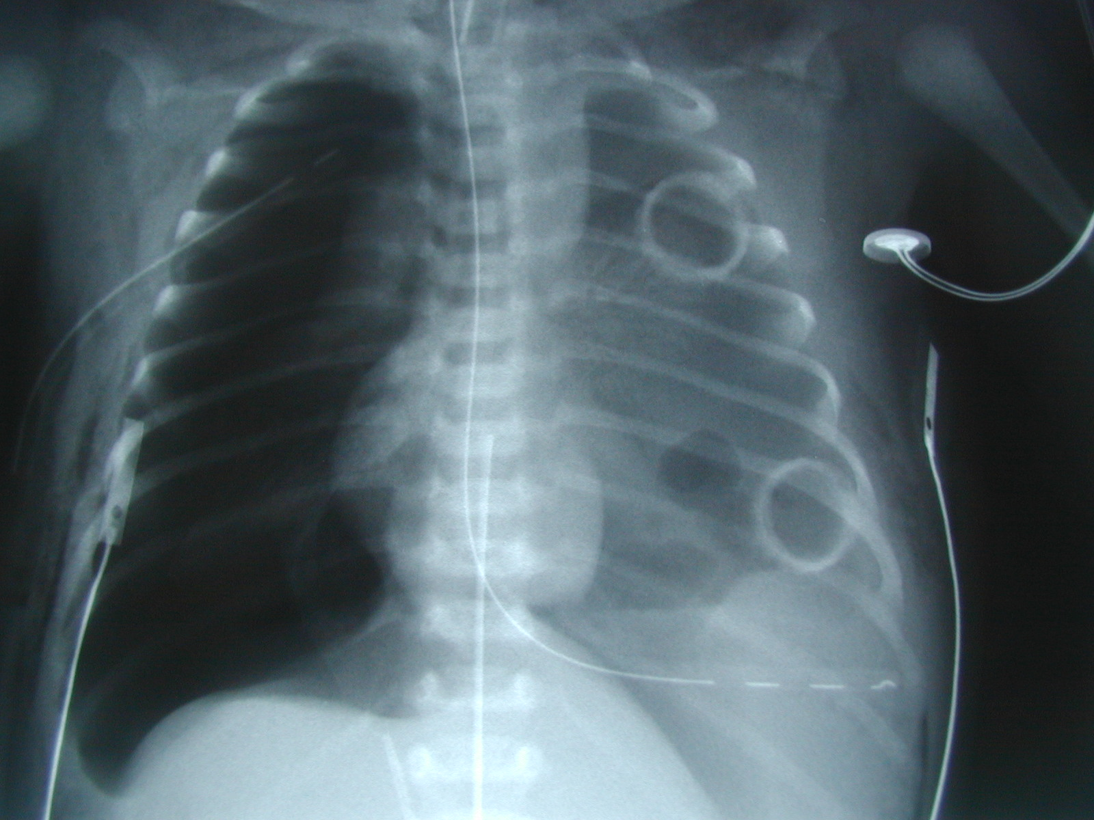
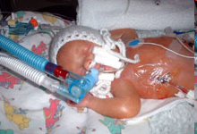
Air leak
Lung compliance
Gestational age
Flow of gases
CPAP pressure
Notes:
Air leaks sometime occur in a baby on CPAP. Although poor compliance and gestation are non-modifiable risk factors, flow and pressures are modifiable risk factors.

Slide 9
Summary
  Nasal injury, skin injury & air leaks are preventable
Notes:
Nasal Injury, Skin Injury and Air leaks are preventable complications of CPAP

